Slide 1
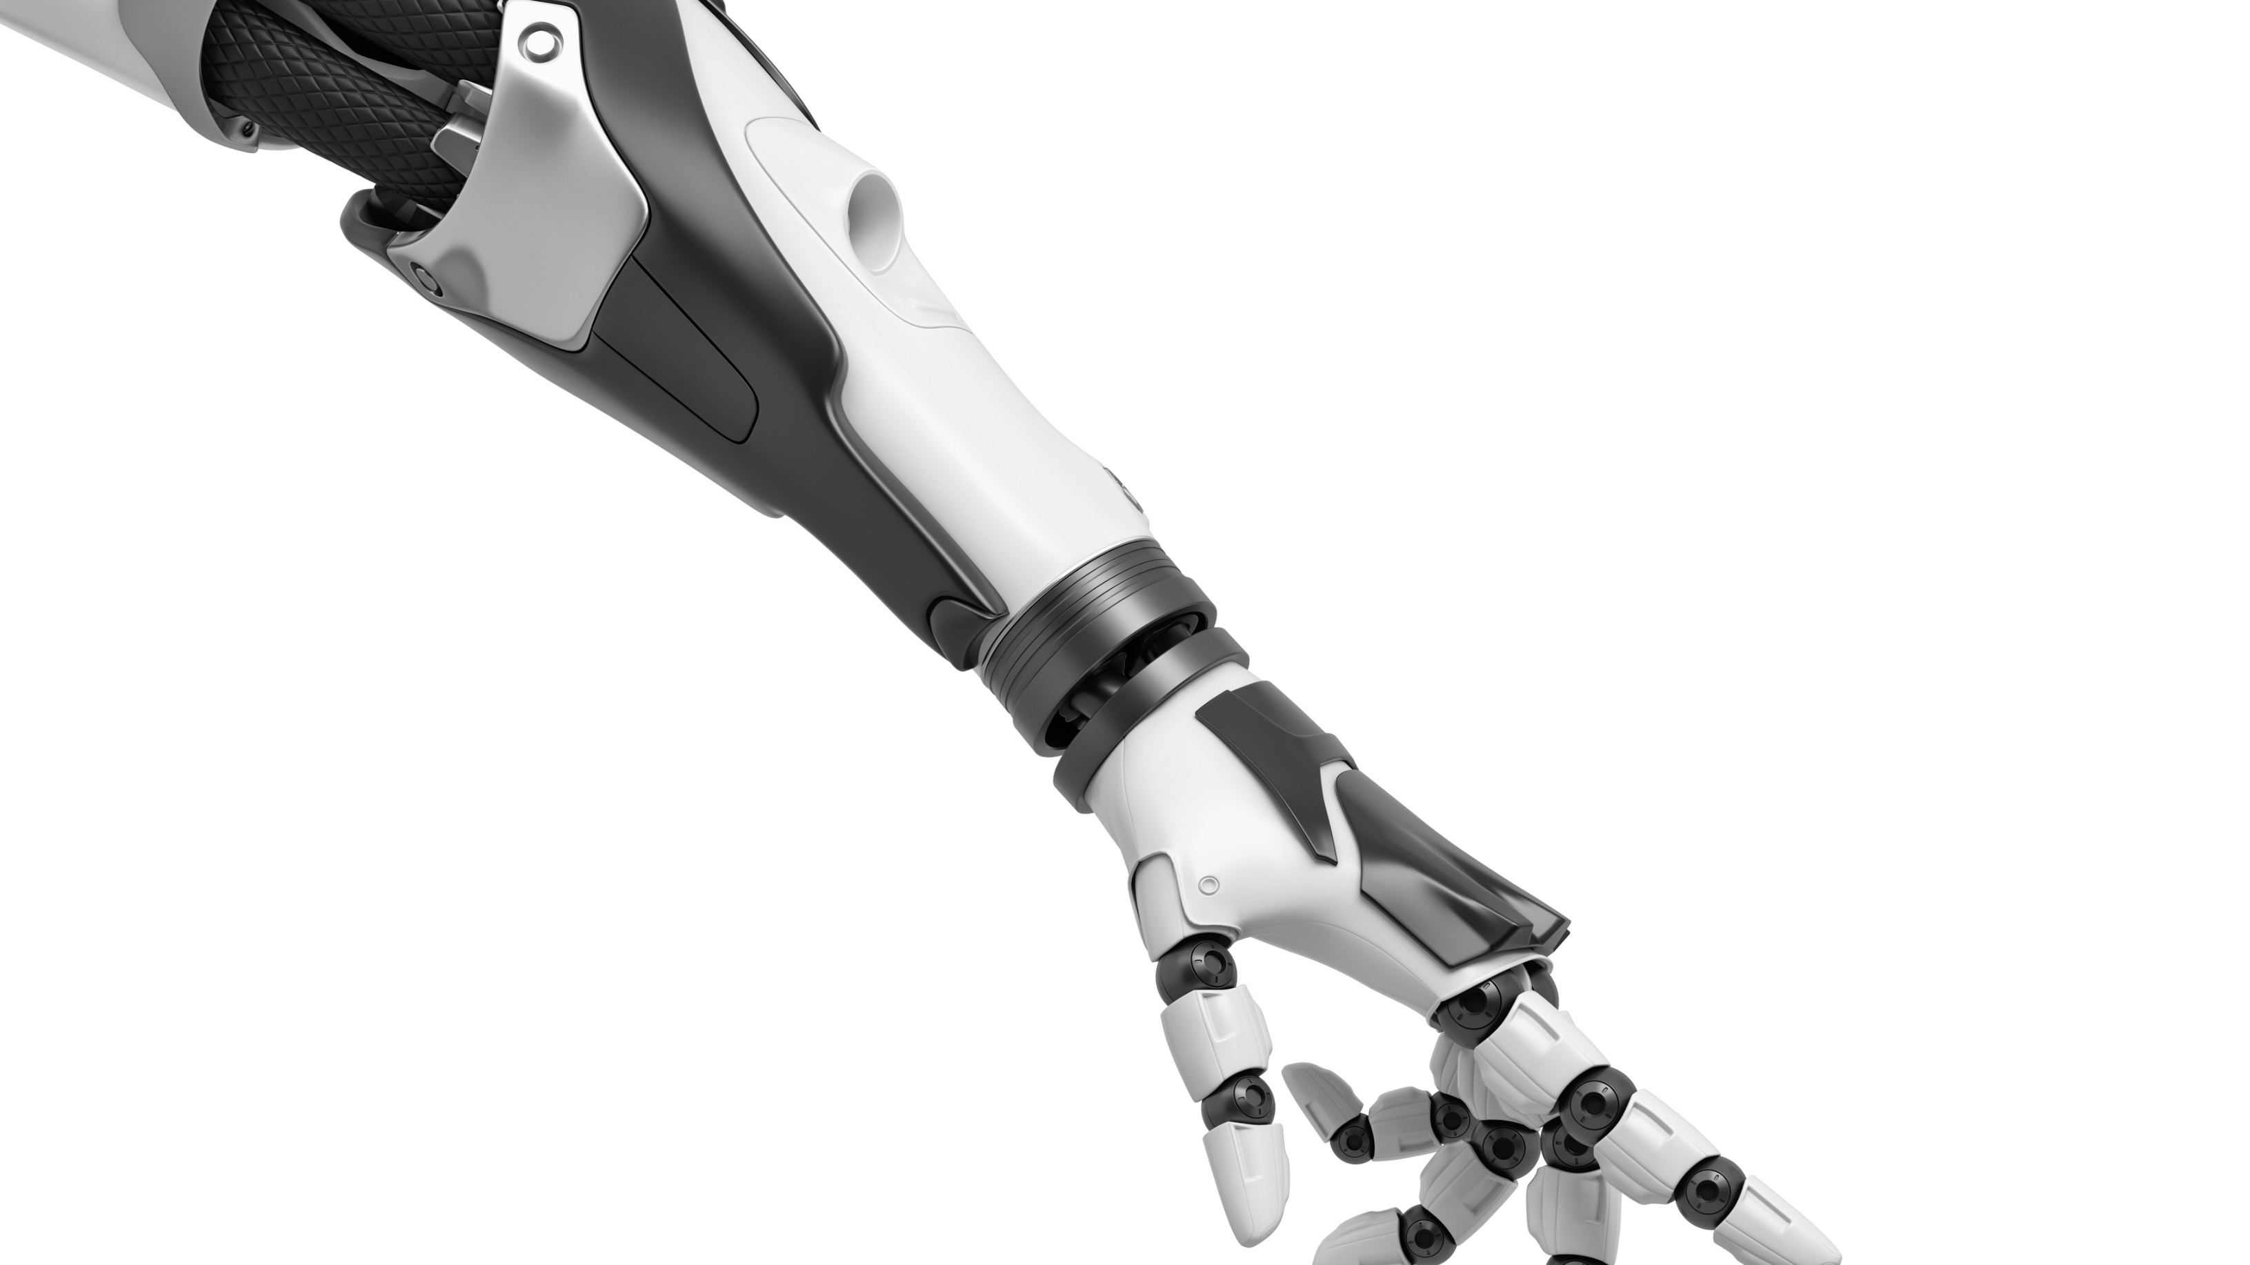

Artificial Intelligence Assignment 2 Msc. in Computational Data Science A.Y. 2021/2022, Summer Semester
Ceol Samuele
Fanti Coelho Lima Rachel
Hooshyar Hosna

Slide 2



Wumpus offline
ALGORITHMS AND HEURISTIC
WORLDS
RESULTS

Slide 3


Wumpus offline
ALGORITHMS AND HEURISTIC
WORLDS
RESULTS

Slide 4
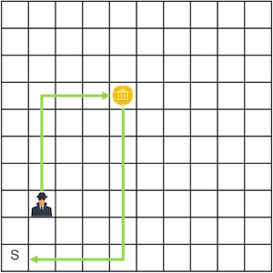
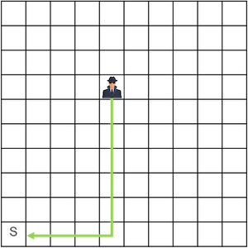
Heuristics and the goal state
NONE (UCS)
MANHATTAN_SIMPLE
MANHATTAN_PIVOTS
MANHATTAN_OBSTACLE
MANHATTAN_ITER_SHIFT
FLOOD_FILL
AREA PRUNNING
Target
Origin
Origin
Target
(1) Before grabbing the gold
(2) After having grabbed the gold

Slide 5
Heuristics – Fixed costs
All heuristics account for some fixed costs of actions that the agent will surely need to execute:
If the gold is still on the grid, the cost for the grab action is added to the heuristic.
If the agent has yet to climb out of the cave, the cost for the climb action is added to the heuristic.
If Wumpus and gold are located on the same tile, the kill is mandatory and the cost for the shoot action is added to the heuristic.

Slide 6
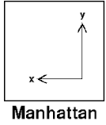



Manhattan distance (MANHATTAN_SIMPLE)
S
7 moves to reach the gold
9 moves to exit

Slide 7


Pivots for the Manhattan path (MANHATTAN_PIVOTS)
 | NW |  | N |  | NE
W |  |  |  |  |  | E
 | SW |  |  |  | SE
 |  |  | S
(1)
(2)
(3)
Agent pivots | 0 | 1 | 2
Path pivots | 0 (N) 1 (NE, NW) | 0 (E, W) 1 (NW, SE) | 0

Slide 8


Obstacles in the Manhattan path (MANHATTAN_OBSTACLE)
(1)
(2)
Additional actions:
3 pivots
2 moves
Additional actions:
1 pivot

Slide 9
Iterative shifting of the Manhattan path (MANHATTAN_ITERATIVE_SHIFT)
Starting path is straight:
Shift on the directions adjacent to the original travel direction (Traveling dir. Is N, path is shifted towards E and W)
+2 extra moves per lateral shift until a free alternative is found

Slide 10
Iterative shifting of the Manhattan path (MANHATTAN_ITERATIVE_SHIFT)
Starting path is elbow shaped:
Can be decomposed into an agent path (green) and a perpendicular path (red)
Scenario 1: Pit appears on the agent path:
Path is shifted towards the agent until a free alternative is found
No extra moves are added

Slide 11
Iterative shifting of the Manhattan path (MANHATTAN_ITERATIVE_SHIFT)
Scenario 2: Pit appears on the perpendicular path:
Path is shifted towards the agent until a free alternative is found
No extra moves are added
If shifting toward the agent is unsuccessful
Path is shifted away from the agent
+2 extra moves per shift until a free alternative is found

Slide 12

Flood filling from start and gold locations (FLOOD_FILL)
Executed once per game
Once from the start location
The game is impossible if:
Gold is not among the flooded tiles (green)
All border tiles (red) are pits
(1)
Impossible game

Slide 13
Flood filling from agent and gold locations (FLOOD_FILL)
Once from the gold location
The game is impossible if:
Agent is not among the flooded tiles (green)
All border tiles (red) are pits
The game requires a mandatory kill if:
Agent is not among the flooded tiles (green)
The Wumpus is among the border tiles (red)
(2)
Kill the Wumpus

Slide 14
Pruning nodes based on start-gold area (AREA_PRUNING)
Selecting start-gold area
Flooding the area
Chosen (red) vs optimal (green) path

Slide 15

Wumpus offline
ALGORITHMS AND HEURISTIC
WORLDS
RESULTS

Slide 16
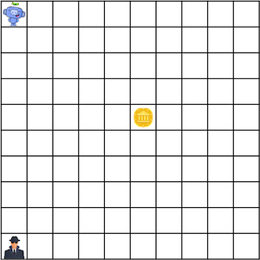
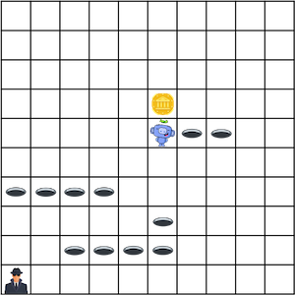
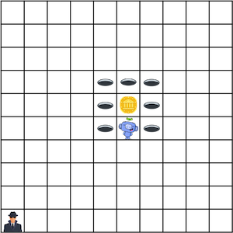
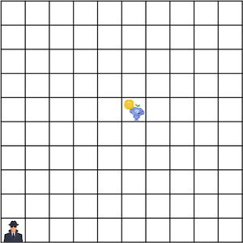
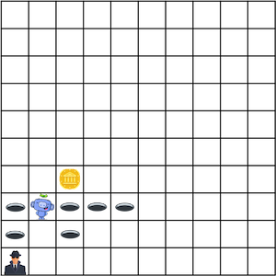
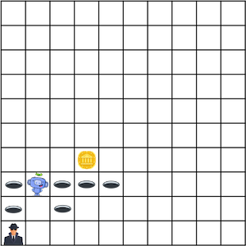
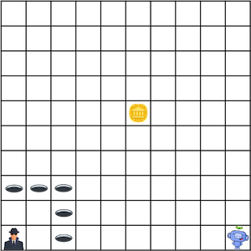
Worlds
1
2
3
4
5
6
7

Slide 17
Wumpus offline
ALGORITHMS AND HEURISTIC
WORLDS
RESULTS

Slide 18
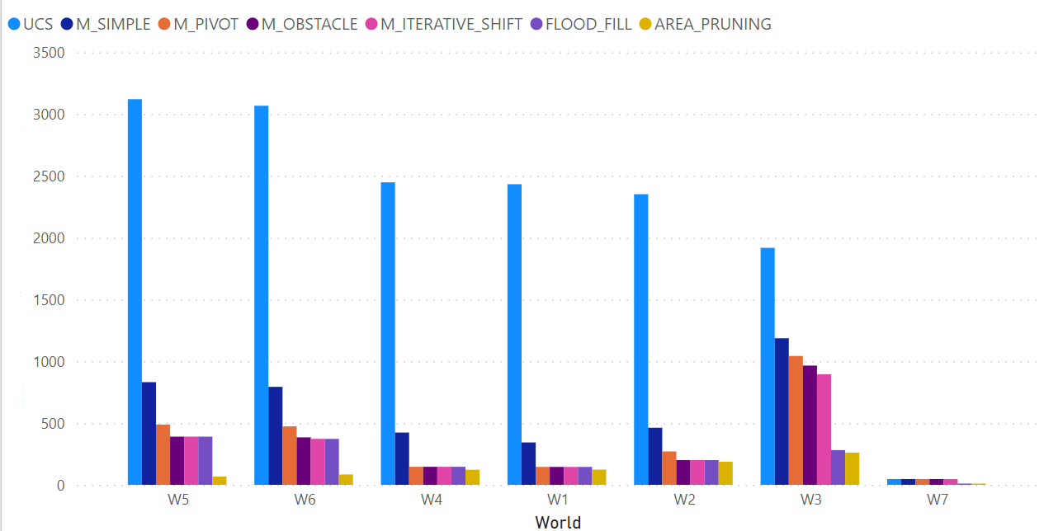
Results
Number of nodes

Slide 19
Thank you for your attention

